Slide 1
Module 3: UI Buttons
SER 423

Slide 2
UI Discussion
If you remember something we discussed previously is that the UI is more important in mobile apps than most regular applications
Again, this is because the User has a much more limited number of ways to interface with your app
  No mouse or keyboard
This makes it important that we communicate effectively with the User as to what their options are in a given situation or context
We need ways to allow both for User interaction and to clearly organize the View
We’ll start with styles as a way to format elements in the View
We’ll also look at buttons as a way of interacting (beyond the TabNavigation used last time)

Slide 3
Styles

Slide 4
Introduction to Styles
You’ve likely already seen styles come up in some of the recipes you’ve used
These provide a set of rules for react to follow for how a given element should be rendered
There are a lot of elements, but text and containers are the most commonly used ones for making View layouts
Expo provides a helper library for making custom fonts
  It used to be very difficult
We create a style by using the StyleSheet.create
This allows us to define a map of properties
Each key is a style
Under each key, we will store our values for each property we wish to override
Then, in render, when we create an element, we pass the style we want as a property

Slide 5
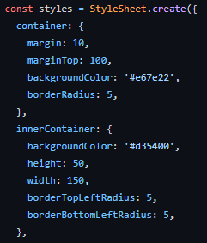
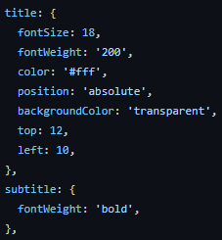
Creating a Style Set

Slide 6
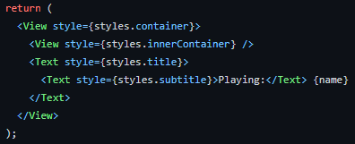
Using Styles Within Render

Slide 7
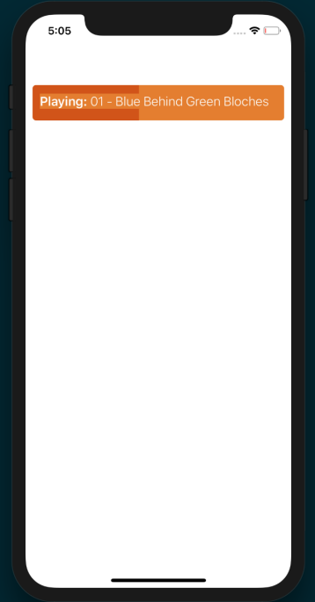
The Result

Slide 8
Styles Wrap Up
There’s really not that much more to say about styles
They provide a lot of flexibility in how you want your elements to look
A style is inherited by any child components
For your assignments, I am going to largely leave the details of appearance up to you
It’s your app, it should look how you want it to
Feel free to experiment with styles and find what you like
And unless something is needed for the assignment, you can stick with the default styling to most elements most of the time
Colors and font size are probably the most important properties that you’ll want to change

Slide 9
Buttons

Slide 10
Introduction to Buttons
If you’ve ever worked with buttons before, this setup should be familiar to you
In other libraries, such as JavaFX, we set up a listener method that is called when the button is pressed
Buttons here work on a similar idea
Each button has an onPress property where you can define a function to be called when the button is pressed
This type of system is called a callback function
You then place the logic for how to respond to the button being pressed in that callback function
The render function for the button itself returns a TouchableOpacity, where you set the onPress property to be that callback function

Slide 11
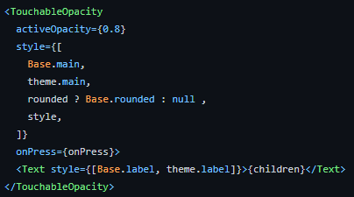
The TouchableOpacity

Slide 12
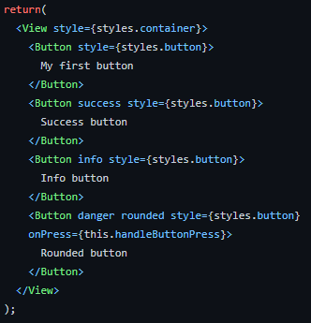
Creating a Button

Slide 13

The Callback Function

Slide 14
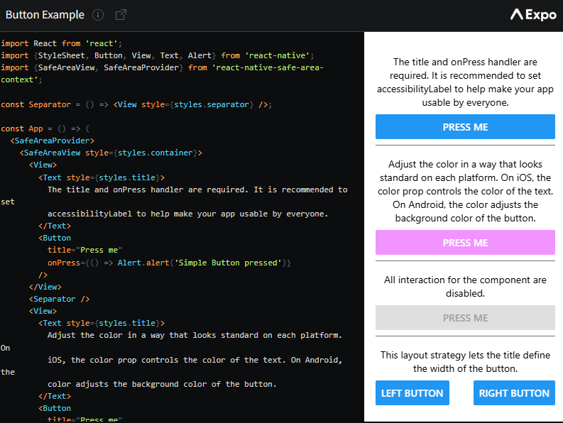
A Second Complete Example
https://reactnative.dev/docs/button

Slide 15
Wrapping Up Buttons
Buttons are an obvious way to both direct the User and to get input from them
Since they call a function when they’re activated, you can have the button do essentially anything
Buttons are booleans, they can only call one function
If you have multiple things the User can do, you will need to provide multiple buttons
Think carefully about space and presentation, but otherwise there is no actual limit on how many buttons you can display

Slide 16
End of Part 1
Next Time - Lists

